Slide 1
The Simple Analytics of Trade Creation and Diversion
Alan V. Deardorff
University of Michigan
Rishi R. Sharma
Colgate University
For presentation at
Conference on International Economic Integration:
Firms, Workers, and Policies
Universität Tübingen
May 22-23, 2019

Slide 2
To Willi
Known since his year at Michigan in the 1980s
Visited him and Gabi in Essen, Linz, and Tübingen
Have admired his work throughout
Delighted to be here to honor him

Slide 3
My Topic
FTAs
Willi has touched on these throughout his career, as have most of us in the trade field

Slide 4
Outline
Background
3-country case, in graphs
Somewhat more general case, in equations
4-country case, in graphs

Slide 5
Background
Viner’s (1950) trade creation and trade diversion are usually illustrated with
Constant costs
2-country FTA or CU plus rest of world
We’ll look here at cases with
Upward sloping supplies
And in the last case, an FTA with pre-existing other FTA

Slide 6
3-country case*
Three countries, importer A, and exporters B, and C
Export supply and import demands are linear
Countries B and C are identical
Two equilibria
0: MFN specific tariff t on exports of both B and C
1: FTA of A and B:
tariff t on exports of C;
zero tariff on exports of B
For simplicity
*Much of this is an elaboration of material in World Trade Organization, "Causes and Effects of PTAs: Is it all about preferences?", Ch. C: World Trade Report 2011, pp. 92-121.

Slide 7






Export Supplies
Export Supplies of B and C
Exports to Country A
P
$X^{Bt}, X^{Ct}$
P
$X^{Bt}+X^{Ct}$
$X^{Bf}, X^{Cf}$
$X^{Bf}+X^{Ct}$
$$t$$
$a^{B}=a^{C}$
Q
Q

Slide 8





MFN Equilibrium
Export Supplies
Import Market
P
$X^{Bt}, X^{Ct}$
P
$X^{Bt}+X^{Ct}$
$X^{Bf}, X^{Cf}$
$$p_{0}^{A}$$
$X^{Bf}+X^{Ct}$
$$M^{A}$$
$$t$$
$a^{B}=a^{C}$
$$X_{0}^{B}=X_{0}^{C}$$
Q
$$M_{0}^{A}{=X}_{0}^{B}+X_{0}^{C}$$
Q

Slide 9








FTA Equilibrium
Export Supplies
Import Market
P
$X^{Bt}, X^{Ct}$
P
$X^{Bt}+X^{Ct}$
$X^{Bf}, X^{Cf}$
$$p_{0}^{A}$$
$X^{Bf}+X^{Ct}$
$$p_{1}^{A}$$
$$M^{A}$$
$$t$$
$a^{B}=a^{C}$
$$X_{0}^{B}$$
$$=X_{0}^{C}$$
Q
Q
$$X_{1}^{C}$$
$$X_{1}^{B}$$
$$M_{0}^{A}$$
$$M_{1}^{A}$$

Slide 10














Trade Creation and Diversion
Export Supplies
Import Market
P
$X^{Bt}, X^{Ct}$
P
$X^{Bt}+X^{Ct}$
$X^{Bf}, X^{Cf}$
$$p_{0}^{A}$$
$X^{Bf}+X^{Ct}$
$$p_{1}^{A}$$
$$M^{A}$$
$$t$$
$a^{B}=a^{C}$
TD
TC
$$X_{0}^{B}$$
$$=X_{0}^{C}$$
Q
Q
$$X_{1}^{C}$$
$$X_{1}^{B}$$
$$M_{0}^{A}$$
$$M_{1}^{A}$$

Slide 11


TC & TD, another View
Export Supplies
Import Market
$p^{A}$
$p^{A}$
$X^{Bt}, X^{Ct}$
$X^{Bt}+X^{Ct}$
$X^{Bf}, X^{Cf}$
$$p_{0}^{A}$$
$X^{Bf}+X^{Ct}$
$$p_{1}^{A}$$
$$M^{A}$$
$$t$$
TD
$a^{B}=a^{C}$
TC
TC
TD
$$X_{0}^{B}$$
$$=X_{0}^{C}$$
Q
Q
$$X_{1}^{C}$$
$$X_{1}^{B}$$
$$M_{0}^{A}$$
$$M_{1}^{A}$$

Slide 12



Welfare Effects on Country A
Export Supplies
Import Market
$p^{A}$
Net gain of A’s private sector
Tariff revenue lost from
B C
$p^{A}$
$X^{Bt}, X^{Ct}$
$X^{Bt}+X^{Ct}$
$X^{Bf}, X^{Cf}$
$$p_{0}^{A}$$
$X^{Bf}+X^{Ct}$
$$p_{1}^{A}$$
$$M^{A}$$
$$t$$
TD
$$a^{B}=a^{C}$$
TC
TC
TD
$$X_{0}^{B}$$
$$=X_{0}^{C}$$
Q
Q
$$X_{1}^{C}$$
$$X_{1}^{B}$$
$$M_{0}^{A}$$
$$M_{1}^{A}$$
See immediately that country A
Gains from trade creation
Loses from trade diversion
As well as from lost revenue from country B

Slide 13

Welfare Effects on Countries B and C
Export Supplies
Import Market
$p^{A}$
$p^{A}$
Gain by partner country B
$X^{Bt}, X^{Ct}$
$X^{Bt}+X^{Ct}$
$X^{Bf}, X^{Cf}$
$$p_{0}^{A}$$
$X^{Bf}+X^{Ct}$
$$p_{1}^{A}$$
Loss by outside country C
$$M^{A}$$
$$t$$
TD
$$a^{B}=a^{C}$$
TC
TC
TD
$$X_{0}^{B}$$
$$=X_{0}^{C}$$
Q
Q
$$X_{1}^{C}$$
$$X_{1}^{B}$$
$$M_{0}^{A}$$
$$M_{1}^{A}$$

Slide 14


Welfare Effects on the World
Export Supplies
Import Market
$p^{A}$
$p^{A}$
$X^{Bt}, X^{Ct}$
$X^{Bt}+X^{Ct}$
$X^{Bf}, X^{Cf}$
$$p_{0}^{A}$$
$X^{Bf}+X^{Ct}$
$$p_{1}^{A}$$
$$M^{A}$$
$$t$$
TD
$$a^{B}=a^{C}$$
TC
TC
TD
$$X_{0}^{B}$$
$$=X_{0}^{C}$$
Q
Q
$$X_{1}^{C}$$
$$X_{1}^{B}$$
$$M_{0}^{A}$$
$$M_{1}^{A}$$
These add up, with much cancellation to yield the following:

Slide 15
Welfare Effects on the World
Export Supplies
Import Market
$p^{A}$
$p^{A}$
$X^{Bt}, X^{Ct}$
$X^{Bt}+X^{Ct}$
$X^{Bf}, X^{Cf}$
$$p_{0}^{A}$$
$X^{Bf}+X^{Ct}$
$$p_{1}^{A}$$
$$M^{A}$$
$$t$$
TD
$$a^{B}=a^{C}$$
TC
TC
TD
$$X_{0}^{B}$$
$$=X_{0}^{C}$$
Q
Q
$$X_{1}^{C}$$
$$X_{1}^{B}$$
$$M_{0}^{A}$$
$$M_{1}^{A}$$
These add up, with much cancellation to yield the following:

Slide 16
Welfare Effects on the World
Export Supplies
Import Market
$p^{A}$
$p^{A}$
$X^{Bt}, X^{Ct}$
$X^{Bt}+X^{Ct}$
$X^{Bf}, X^{Cf}$
$$p_{0}^{A}$$
$X^{Bf}+X^{Ct}$
$$p_{1}^{A}$$
$$M^{A}$$
$$t$$
TD
$$a^{B}=a^{C}$$
TC
TC
TD
$$X_{0}^{B}$$
$$=X_{0}^{C}$$
Q
Q
$$X_{1}^{C}$$
$$X_{1}^{B}$$
$$M_{0}^{A}$$
$$M_{1}^{A}$$
These add up, with much cancellation to yield the following:

Slide 17
Welfare Effects on the World
Export Supplies
Import Market
$p^{A}$
$p^{A}$
$X^{Bt}, X^{Ct}$
$X^{Bt}+X^{Ct}$
$X^{Bf}, X^{Cf}$
$$p_{0}^{A}$$
$X^{Bf}+X^{Ct}$
$$p_{1}^{A}$$
$$M^{A}$$
$$t$$
TD
$$a^{B}=a^{C}$$
TC
TC
TD
$$X_{0}^{B}$$
$$=X_{0}^{C}$$
Q
Q
$$X_{1}^{C}$$
$$X_{1}^{B}$$
$$M_{0}^{A}$$
$$M_{1}^{A}$$
These add up, with much cancellation to yield the following:

Slide 18
Welfare Effects on the World
Export Supplies
Import Market
$p^{A}$
$p^{A}$
$X^{Bt}, X^{Ct}$
$X^{Bt}+X^{Ct}$
$X^{Bf}, X^{Cf}$
$$p_{0}^{A}$$
$X^{Bf}+X^{Ct}$
$$p_{1}^{A}$$
=
$$M^{A}$$
$$t$$
TD
$$a^{B}=a^{C}$$
TC
TC
TD
$$X_{0}^{B}$$
$$=X_{0}^{C}$$
Q
Q
$$X_{1}^{C}$$
$$X_{1}^{B}$$
$$M_{0}^{A}$$
$$M_{1}^{A}$$
These add up, with much cancellation to yield the following:

Slide 19
Welfare Effects on the World
Export Supplies
Import Market
$p^{A}$
$p^{A}$
$X^{Bt}, X^{Ct}$
$X^{Bt}+X^{Ct}$
$X^{Bf}, X^{Cf}$
$$p_{0}^{A}$$
$X^{Bf}+X^{Ct}$
$$p_{1}^{A}$$
$$M^{A}$$
$$t$$
TD
$$a^{B}=a^{C}$$
TC
TC
TD
$$X_{0}^{B}$$
$$=X_{0}^{C}$$
Q
Q
$$X_{1}^{C}$$
$$X_{1}^{B}$$
$$M_{0}^{A}$$
$$M_{1}^{A}$$
These add up, with much cancellation to yield the following:

Slide 20
Welfare Effects on the World
Export Supplies
Import Market
$p^{A}$
$p^{A}$
$X^{Bt}, X^{Ct}$
$X^{Bt}+X^{Ct}$
$X^{Bf}, X^{Cf}$
$$p_{0}^{A}$$
$X^{Bf}+X^{Ct}$
$$p_{1}^{A}$$
$$M^{A}$$
$$t$$
TD
$$a^{B}=a^{C}$$
TC
TC
TD
$$X_{0}^{B}$$
$$=X_{0}^{C}$$
Q
Q
$$X_{1}^{C}$$
$$X_{1}^{B}$$
$$M_{0}^{A}$$
$$M_{1}^{A}$$
These add up, with much cancellation to yield the following:

Slide 21
Welfare Effects on the World
Export Supplies
Import Market
$p^{A}$
$p^{A}$
Loss from trade diversion
$X^{Bt}+X^{Ct}$
$X^{Bt}, X^{Ct}$
$X^{Bf}, X^{Cf}$
$$p_{0}^{A}$$
$X^{Bf}+X^{Ct}$
$$p_{1}^{A}$$
Gain from trade creation
$$M^{A}$$
$$t$$
TD
$a^{B}=a^{C}$
TC
TC
TD
$$X_{0}^{B}$$
$$=X_{0}^{C}$$
Q
Q
$$X_{1}^{C}$$
$$X_{1}^{B}$$
$$M_{0}^{A}$$
$$M_{1}^{A}$$

Slide 22






Why the Loss from Trade Diversion
Export Supplies
Import Market
$p^{A}$
$p^{A}$
$X^{Bt}, X^{Ct}$
$X^{Bt}+X^{Ct}$
$X^{Bf}, X^{Cf}$
$$p_{0}^{A}$$
$X^{Bf}+X^{Ct}$
$$p_{1}^{A}$$
$$M^{A}$$
$$t$$
TD
$a^{B}=a^{C}$
TC
TC
TD
$$X_{0}^{B}$$
$$=X_{0}^{C}$$
Q
Q
$$X_{1}^{C}$$
$$X_{1}^{B}$$
$$M_{0}^{A}$$
$$M_{1}^{A}$$
C’s fall in cost
B’s rise in cost

Slide 23
Welfare Effects on the World
Export Supplies
Import Market
$p^{A}$
$p^{A}$
Loss from trade diversion
$X^{Bt}+X^{Ct}$
$X^{Bt}, X^{Ct}$
$X^{Bf}, X^{Cf}$
$$p_{0}^{A}$$
$X^{Bf}+X^{Ct}$
$$p_{1}^{A}$$
Gain from trade creation
$$M^{A}$$
$$t$$
TD
$a^{B}=a^{C}$
TC
TC
TD
$$X_{0}^{B}$$
$$=X_{0}^{C}$$
Q
Q
$$X_{1}^{C}$$
$$X_{1}^{B}$$
$$M_{0}^{A}$$
$$M_{1}^{A}$$
Loss is an area, product of the price change and the quantity of trade diversion, with the latter depending on the former.
So the loss rises with the square of trade diversion.

Slide 24

The Model
Four countries:
Importer A
Exporters B, C, and D
Export supply and import demands are linear
Three equilibria
0: MFN tariff t on exports of B, C, and D
1: FTA of A and D:
Tariff t on exports of B and C;
Zero tariff on exports of D
2: FTA of A with B, keeping FTA with D
Tariff t on exports of C only
Zero tariff on exports of B and D
Consider only cases with
$$X^{i}>0, i=B,C,D$$

Slide 25

The Model
Exports:
Imports:
Equilibrium:
$$X^{i}=b^{i}\left(p^{i}−a^{i}\right), i=B,C,D, p^{i}≥a^{i}$$
$$M^{A}=b^{A}\left(a^{A}−p^{A}\right), { p}^{A}≤a^{A}$$
$$M^{A}=X^{B}+X^{C}+X^{D}$$

Slide 26


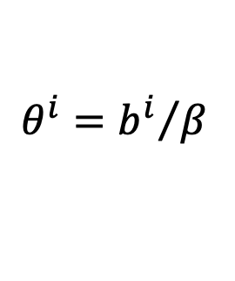

The Model
Let:
Then solution is:
$$β=b^{A}+b^{B}+b^{C}+b^{D}$$
$$θ^{i}={b^{i}}/β$$
$$γ=θ^{A}a^{A}+θ^{B}a^{B}+θ^{C}a^{C}+θ^{D}a^{D}$$
$$p^{A}=γ+θ^{B}t^{B}+θ^{C}t^{C}+θ^{D}t^{D}$$

Slide 27

The Model
With more assumptions, $b^{i}$ are proportional to country size
(See paper)
Therefore $θ^{i}$ is country i’s share of world economy
(This is not really right, as it assumes both demanders and suppliers in proportion to population. Exporters will in fact have more firms, and thus greater weight, than importers.)

Slide 28




The Model
Effect of new FTA between A and B
(in presence of A’s FTA with D)
Let $∆$ be change from equilibrium 1 to equilibrium 2
Thus price in A falls by a fraction of the tariff, in proportion to size of new partner compared to world.
Country B’s price rises by the rest of the tariff
Because A’s tariff on C and D does not change
$$∆p^{A}=−θ^{B}t$$
$$∆p^{B}=(1−θ^{B})t$$
$$∆p^{C}=∆p^{D}=∆p^{A}=−θ^{B}t$$

Slide 29




The Model
From the price changes, one derives the following changes in quantities of trade:
$${∆M}^{A}=θ^{B}b^{A}t>0$$
$${∆X}^{B}=θ^{B}\left({b^{A}+b}^{C}+a^{D}\right)t>0$$
$${∆X}^{C}=−θ^{B}b^{C}t<0$$
$${∆X}^{D}=−θ^{B}b^{D}t<0$$

Slide 30
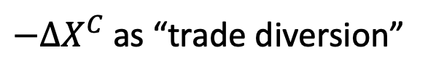

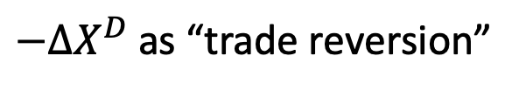
The Model
As must be from market equilibrium
Thus the added exports of the partner country include the new imports of country A plus the reduced exports of countries C and D. The latter trade may be said to be “diverted,” but we label
and
because it is reversal of trade diversion from the prior FTA.
${∆X}^{B}={∆M}^{A}−{∆X}^{C}$ $−{∆X}^{D}$
$−{∆X}^{C}$ as “trade diversion”
$−{∆X}^{D}$ as “trade reversion”

Slide 31



The Model
Thus
$$Trade Creation=TC=θ^{B}b^{A}t>0$$
$$Trade Diversion=TD=θ^{B}b^{C}t>0$$
$$Trade Reversion=TR=θ^{B}b^{D}t>0$$

Slide 32
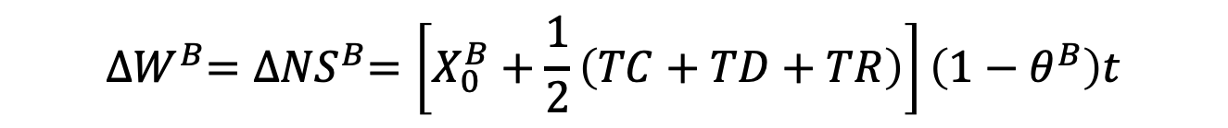
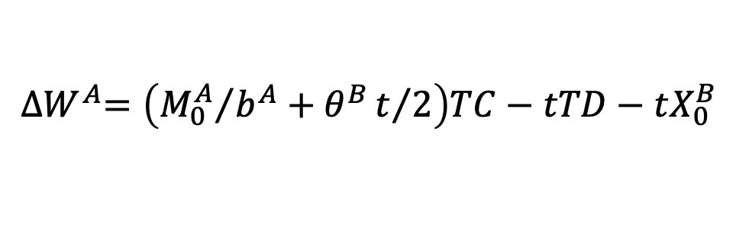
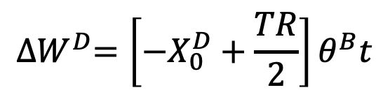
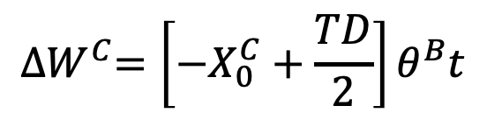
The Model
Welfare effects of new FTA
Country A (home):
Country B (new partner):
Country C (outside world):
Country D (old partner):
Lost tariff revenue
$${∆W}^{A}=\left({M_{0}^{A}}/{b^{A}}+θ^{B}t/2\right)TC−tTD−tX_{0}^{B}$$
$${∆W}^{B}={∆NS}^{B}=\left[X_{0}^{B}+\frac{1}{2}\left(TC+TD+TR\right)\right]\left(1−θ^{B}\right)t$$
$${∆W}^{C}=\left[−X_{0}^{C}+\frac{TD}{2}\right]θ^{B}t$$
$${∆W}^{D}=\left[−X_{0}^{D}+\frac{TR}{2}\right]θ^{B}t$$

Slide 33
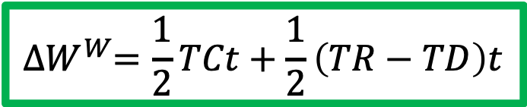
The Model
Welfare effects of new FTA on the World
World (A+B+C+D):
$${∆W}^{W}=\frac{1}{2}TCt+\frac{1}{2}\left(TR−TD\right)t$$

Slide 34
4-country case
Three countries, importer A, and exporters B, C, and D
Export supply and import demands are linear
Countries B, C, and D are identical
Two equilibria
1: MFN tariff t on exports of both B and C
Zero tariff on exports of old FTA partner D
2: New FTA of A and B:
tariff t on exports of C only;
zero tariff on exports of two FTA partners B and D
For simplicity

Slide 35









Export Supplies
Export Supplies of B, C, and D
Export Supplies to Country B
P
$$X^{Bt}, X^{Ct},X^{Dt}$$
P
${{∑X}_{1}=X}^{Bt}+X^{Ct}$ $+X^{Df}$
$X^{Bf}, { X}^{Cf}$, $X^{Df}$
${{∑X}_{0}=X}^{Bt}+X^{Ct}$ $+X^{Dt}$
${{∑X}_{2}=X}^{Bf}+X^{Ct}$ $+X^{Df}$
$$t$$
$a^{B}=a^{C}$ = $a^{D}$
$b^{B}=b^{C}$ = $b^{D}$
${{∑X}_{f}=X}^{Bf}+X^{Cf}$ $+X^{Df}$
Q
Q

Slide 36



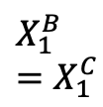


Equilibrium 1: A has FTA with 1 country, D
Export Supplies of B, C, and D
Import Market
P
$$X^{Bt}, X^{Ct},X^{Dt}$$
P
$${∑X}_{1}$$
$X^{Bf}, { X}^{Cf}$, $X^{Df}$
$${∑X}_{2}$$
$$M^{A}$$
$$t$$
$$X_{1}^{B}=X_{1}^{C}$$
$$X_{1}^{D}$$
Q
$$M_{1}^{A}$$
$${=X}_{1}^{B}+X_{1}^{C}+X_{1}^{D}$$
Q

Slide 37



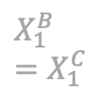

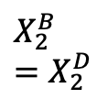


Equilibrium 2: A has FTA with 2 countries, B & D
Export Supplies of B, C, and D
Import Market
P
$$X^{Bt}, X^{Ct},X^{Dt}$$
P
$${∑X}_{1}$$
$X^{Bf}, { X}^{Cf}$, $X^{Df}$
$${∑X}_{2}$$
$$M^{A}$$
$$t$$
$$X_{2}^{C}$$
$$X_{1}^{B}=X_{1}^{C}$$
$$X_{2}^{B}=X_{2}^{D}$$
$$X_{1}^{D}$$
Q
$$M_{1}^{A}$$
$$M_{2}^{A}$$
Q

Slide 38





Changes in Trade from expanding FTA to Country B
Export Supplies of B, C, and D
Import Market
P
$$X^{Bt}, X^{Ct},X^{Dt}$$
P
$${∑X}_{1}$$
$X^{Bf}, { X}^{Cf}$, $X^{Df}$
$${∑X}_{2}$$
$$M^{A}$$
$$t$$
$${∆X}^{C}$$
$${∆X}^{B}$$
$${∆X}^{D}$$
$${∆M}^{A}$$
$$X_{2}^{C}$$
$$X_{1}^{B}=X_{1}^{C}$$
$$X_{2}^{B}=X_{2}^{D}$$
$$X_{1}^{D}$$
Q
$$M_{1}^{A}$$
$$M_{2}^{A}$$
Q

Slide 39

Trade Creation
Trade Creation (TC), Diversion (TD), and Reversion (TR)
Export Supplies of B, C, and D
Import Market
P
$$X^{Bt}, X^{Ct},X^{Dt}$$
P
$${∑X}_{1}$$
$X^{Bf}, { X}^{Cf}$, $X^{Df}$
$${∑X}_{2}$$
$$M^{A}$$
$$t$$
$${∆X}^{C}$$
$${∆X}^{B}$$
$${∆X}^{D}$$
$${∆M}^{A}$$
TD
TR
TC
Q
Q
Trade Diversion
Trade Reversion
Trade Creation

Slide 40



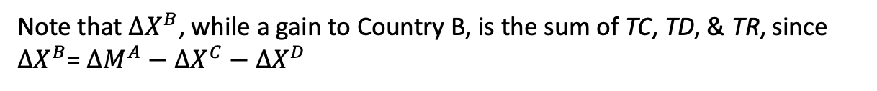

Trade Creation (TC), Diversion (TD), and Reversion (TR)
Export Supplies of B, C, and D
Import Market
P
$$X^{Bt}, X^{Ct},X^{Dt}$$
P
$${∑X}_{1}$$
$X^{Bf}, { X}^{Cf}$, $X^{Df}$
$${∑X}_{2}$$
$$M^{A}$$
$$t$$
$${∆X}^{C}$$
$${∆X}^{B}$$
$${∆X}^{D}$$
$${∆M}^{A}$$
TD
TR
TC
Q
Q
TD
TC
TR
Note that ${∆X}^{B}$, while a gain to Country B, is the sum of TC, TD, & TR, since ${∆X}^{B}$= ${∆M}^{A}−$ ${∆X}^{C}−{∆X}^{D}$

Slide 41



Welfare Effects on Country A
Tariff revenue lost from
Export Supplies of B, C, and D
Import Market
P
$$X^{Bt}, X^{Ct},X^{Dt}$$
P
Net gain of A’s private sector
$${∑X}_{1}$$
B
C
$X^{Bf}, { X}^{Cf}$, $X^{Df}$
$${∑X}_{2}$$
$$M^{A}$$
$$t$$
$${∆X}^{C}$$
$${∆X}^{B}$$
$${∆X}^{D}$$
$${∆M}^{A}$$
TD
TR
TC
$${∆X}^{C}$$
$${∆M}^{A}$$
$${∆X}^{D}$$
Q
Q
TD
TC
TR
Note that trade reversion does not appear to affect A’s welfare. I suspect this is an artifact of making export supplies from B and D the same.

Slide 42
Welfare Effect on Country B
Export Supplies of B, C, and D
Import Market
P
$$X^{Bt}, X^{Ct},X^{Dt}$$
P
$${∑X}_{1}$$
Net gain of B’s private sector
$X^{Bf}, { X}^{Cf}$, $X^{Df}$
$${∑X}_{2}$$
$$M^{A}$$
$$t$$
TD
TR
TC
Q
Q
TD
TC
TR

Slide 43
Welfare Effect on Country C
Export Supplies of B, C, and D
Import Market
P
$$X^{Bt}, X^{Ct},X^{Dt}$$
P
$${∑X}_{1}$$
$X^{Bf}, { X}^{Cf}$, $X^{Df}$
$${∑X}_{2}$$
Net loss of C’s private sector
$$M^{A}$$
$$t$$
TD
TR
TC
Q
Q
TD
TC
TR

Slide 44
Welfare Effect on Country D
Export Supplies of B, C, and D
Import Market
P
Net loss of D’s private sector
$$X^{Bt}, X^{Ct},X^{Dt}$$
P
$${∑X}_{1}$$
$X^{Bf}, { X}^{Cf}$, $X^{Df}$
$${∑X}_{2}$$
$$M^{A}$$
$$t$$
TD
TR
TC
Q
Q
TD
TC
TR

Slide 45
Welfare Effects on World
Export Supplies of B, C, and D
Import Market
P
$$X^{Bt}, X^{Ct},X^{Dt}$$
P
$${∑X}_{1}$$
$X^{Bf}, { X}^{Cf}$, $X^{Df}$
$${∑X}_{2}$$
$$M^{A}$$
$$t$$
TD
TR
TC
Q
Q
TD
TC
TR
I claim that these gains and losses mostly cancel out to reduce to the following:

Slide 46
Welfare Effect on World
Export Supplies of B, C, and D
Import Market
P
$$X^{Bt}, X^{Ct},X^{Dt}$$
P
$${∑X}_{1}$$
$X^{Bf}, { X}^{Cf}$, $X^{Df}$
$${∑X}_{2}$$
$$M^{A}$$
$$t$$
TD
TR
TC
Q
Q
TD
TC
TR

Slide 47
Welfare Effects on World
Export Supplies of B, C, and D
Import Market
P
$$X^{Bt}, X^{Ct},X^{Dt}$$
P
$${∑X}_{1}$$
$X^{Bf}, { X}^{Cf}$, $X^{Df}$
$${∑X}_{2}$$
$$M^{A}$$
$$t$$
TD
TR
TC
Q
Q
TD
TC
TR

Slide 48
Welfare Effects on World
Export Supplies of B, C, and D
Import Market
P
$$X^{Bt}, X^{Ct},X^{Dt}$$
P
$${∑X}_{1}$$
$X^{Bf}, { X}^{Cf}$, $X^{Df}$
$${∑X}_{2}$$
$$M^{A}$$
$$t$$
TD
TR
TC
Q
Q
TD
TC
TR

Slide 49
Welfare Effects on World
Export Supplies of B, C, and D
Import Market
P
$$X^{Bt}, X^{Ct},X^{Dt}$$
P
$${∑X}_{1}$$
$X^{Bf}, { X}^{Cf}$, $X^{Df}$
$${∑X}_{2}$$
$$M^{A}$$
$$t$$
TD
TR
TC
Q
Q
TD
TC
TR

Slide 50
Welfare Effects on World
Export Supplies of B, C, and D
Import Market
P
$$X^{Bt}, X^{Ct},X^{Dt}$$
P
$${∑X}_{1}$$
$X^{Bf}, { X}^{Cf}$, $X^{Df}$
$${∑X}_{2}$$
$$M^{A}$$
$$t$$
TD
TR
TC
Q
Q
TD
TC
TR

Slide 51
Welfare Effects on World
Export Supplies of B, C, and D
Import Market
P
$$X^{Bt}, X^{Ct},X^{Dt}$$
P
$${∑X}_{1}$$
$X^{Bf}, { X}^{Cf}$, $X^{Df}$
$${∑X}_{2}$$
$$M^{A}$$
$$t$$
TD
TR
TC
Q
Q
TD
TC
TR

Slide 52
Welfare Effects on World
Export Supplies of B, C, and D
Import Market
P
$$X^{Bt}, X^{Ct},X^{Dt}$$
P
$${∑X}_{1}$$
$X^{Bf}, { X}^{Cf}$, $X^{Df}$
$${∑X}_{2}$$
$$M^{A}$$
$$t$$
TD
TR
TC
Q
Q
TD
TC
TR

Slide 53
Welfare Effects on World
Export Supplies of B, C, and D
Import Market
P
$$X^{Bt}, X^{Ct},X^{Dt}$$
P
$${∑X}_{1}$$
$X^{Bf}, { X}^{Cf}$, $X^{Df}$
$${∑X}_{2}$$
$$M^{A}$$
$$t$$
TD
TR
TC
Q
Q
TD
TC
TR

Slide 54





Welfare Effects on World
Export Supplies of B, C, and D
Import Market
P
$$X_{1}^{D}$$
$$X^{Bt}, X^{Ct},X^{Dt}$$
P
$${∑X}_{1}$$
$X^{Bf}, { X}^{Cf}$, $X^{Df}$
$$X_{1}^{B}$$
$$X_{1}^{C}$$
$$X_{1}^{D}$$
$$X_{1}^{B}$$
$$=X_{1}^{C}$$
$${∑X}_{2}$$
$$M^{A}$$
$$t$$
TD
TR
TC
Q
Q
TD
TC
TR

Slide 55
Welfare Effects on World
Export Supplies of B, C, and D
Import Market
P
$$X_{1}^{D}$$
$$X^{Bt}, X^{Ct},X^{Dt}$$
P
$${∑X}_{1}$$
$X^{Bf}, { X}^{Cf}$, $X^{Df}$
$$X_{1}^{B}$$
$$X_{1}^{C}$$
$$X_{1}^{D}$$
$$X_{1}^{B}$$
$$=X_{1}^{C}$$
$${∑X}_{2}$$
$$M^{A}$$
$$t$$
TD
TR
TC
Q
Q
TD
TC
TR

Slide 56
Welfare Effects on World
Export Supplies of B, C, and D
Import Market
P
$$X_{1}^{D}$$
$$X^{Bt}, X^{Ct},X^{Dt}$$
P
$${∑X}_{1}$$
$X^{Bf}, { X}^{Cf}$, $X^{Df}$
$$X_{1}^{B}$$
$$X_{1}^{C}$$
$$X_{1}^{D}$$
$$X_{1}^{B}$$
$$=X_{1}^{C}$$
$${∑X}_{2}$$
$$M^{A}$$
$$t$$
TD
TR
TC
Q
Q
TD
TC
TR

Slide 57
Welfare Effects on World
Export Supplies of B, C, and D
Import Market
P
$$X^{Bt}, X^{Ct},X^{Dt}$$
P
$${∑X}_{1}$$
$X^{Bf}, { X}^{Cf}$, $X^{Df}$
$${∑X}_{2}$$
$$M^{A}$$
$$t$$
TD
TR
TC
Q
Q
TD
TC
TR

Slide 58
Welfare Effect on World
Export Supplies of B, C, and D
Import Market
P
$$X^{Bt}, X^{Ct},X^{Dt}$$
P
$${∑X}_{1}$$
$X^{Bf}, { X}^{Cf}$, $X^{Df}$
$${∑X}_{2}$$
$$M^{A}$$
$$t$$
TD
TR
TC
Q
Q
TD
TC
TR

Slide 59
Welfare Effect on World
Export Supplies of B, C, and D
Import Market
P
$$X^{Bt}, X^{Ct},X^{Dt}$$
P
$${∑X}_{1}$$
$X^{Bf}, { X}^{Cf}$, $X^{Df}$
$${∑X}_{2}$$
$$M^{A}$$
$$t$$
TD
TR
TC
Q
Q
TD
TC
TR

Slide 60
Welfare Effect on World
Export Supplies of B, C, and D
Import Market
P
$$X^{Bt}, X^{Ct},X^{Dt}$$
P
$${∑X}_{1}$$
$X^{Bf}, { X}^{Cf}$, $X^{Df}$
$${∑X}_{2}$$
$$M^{A}$$
$$t$$
TD
TR
TC
Q
Q
TD
TC
TR

Slide 61
Welfare Effect on World
Export Supplies of B, C, and D
Import Market
P
$$X^{Bt}, X^{Ct},X^{Dt}$$
P
$${∑X}_{1}$$
$X^{Bf}, { X}^{Cf}$, $X^{Df}$
$${∑X}_{2}$$
$$M^{A}$$
$$t$$
TD
TR
TC
Q
Q
TD
TC
TR

Slide 62
Welfare Effect on World
Export Supplies of B, C, and D
Import Market
P
$$X^{Bt}, X^{Ct},X^{Dt}$$
P
$${∑X}_{1}$$
$X^{Bf}, { X}^{Cf}$, $X^{Df}$
$${∑X}_{2}$$
$$M^{A}$$
$$t$$
TD
TR
TC
Q
Q
TD
TC
TR

Slide 63
Welfare Effect on World
Export Supplies of B, C, and D
Import Market
P
$$X^{Bt}, X^{Ct},X^{Dt}$$
P
$${∑X}_{1}$$
$X^{Bf}, { X}^{Cf}$, $X^{Df}$
$${∑X}_{2}$$
$$M^{A}$$
$$t$$
TD
TR
TC
Q
Q
TD
TC
TR

Slide 64
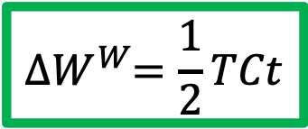
4-country case
Result:
World welfare rises with second FTA, by amount depending on trade creation and the tariff
Recall from model:
Here, because we’ve assumed countries B and D are the same, TR=TD
$${∆W}^{W}=\frac{1}{2}TCt+\frac{1}{2}\left(TR−TD\right)t$$
$${∆W}^{W}=\frac{1}{2}TCt$$

Slide 65
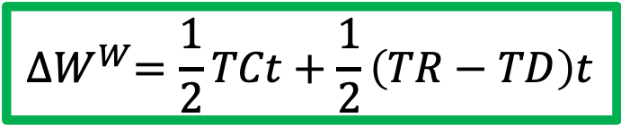

4-country case
In general, $TR≠TD$
Which is larger depends just on country size, size both face the same price change.
If the new partner is smaller than the old, $TR>TD , and world gain will be larger$
If new partner is bigger than old, then $TR<TD$ and world gain will be smaller and perhaps a loss.
$${∆W}^{W}=\frac{1}{2}TCt+\frac{1}{2}\left(TR−TD\right)t$$

Slide 66
Conclusion
Analysis of FTAs shouldn’t treat each independently of FTAs that already exist
Sequencing of FTAs can matter.

Slide 67
Notes:
https://www.datacentermap.com/cloud.html

